Slide 1

DevOps and AWS
adapt DevOps culture to meet your business needs!

Slide 2

Organization's Business Needs
Continuous Delivery
Higher Quality
Cost Optimization / Lesser Spending
Reduced Outages
Software Development Models
Plan

Slide 3

Software Development Models
Waterfall Model
Spiral Model
V - Model
Iterative and Incremental Models
RAD
Agile SDLC

Slide 4
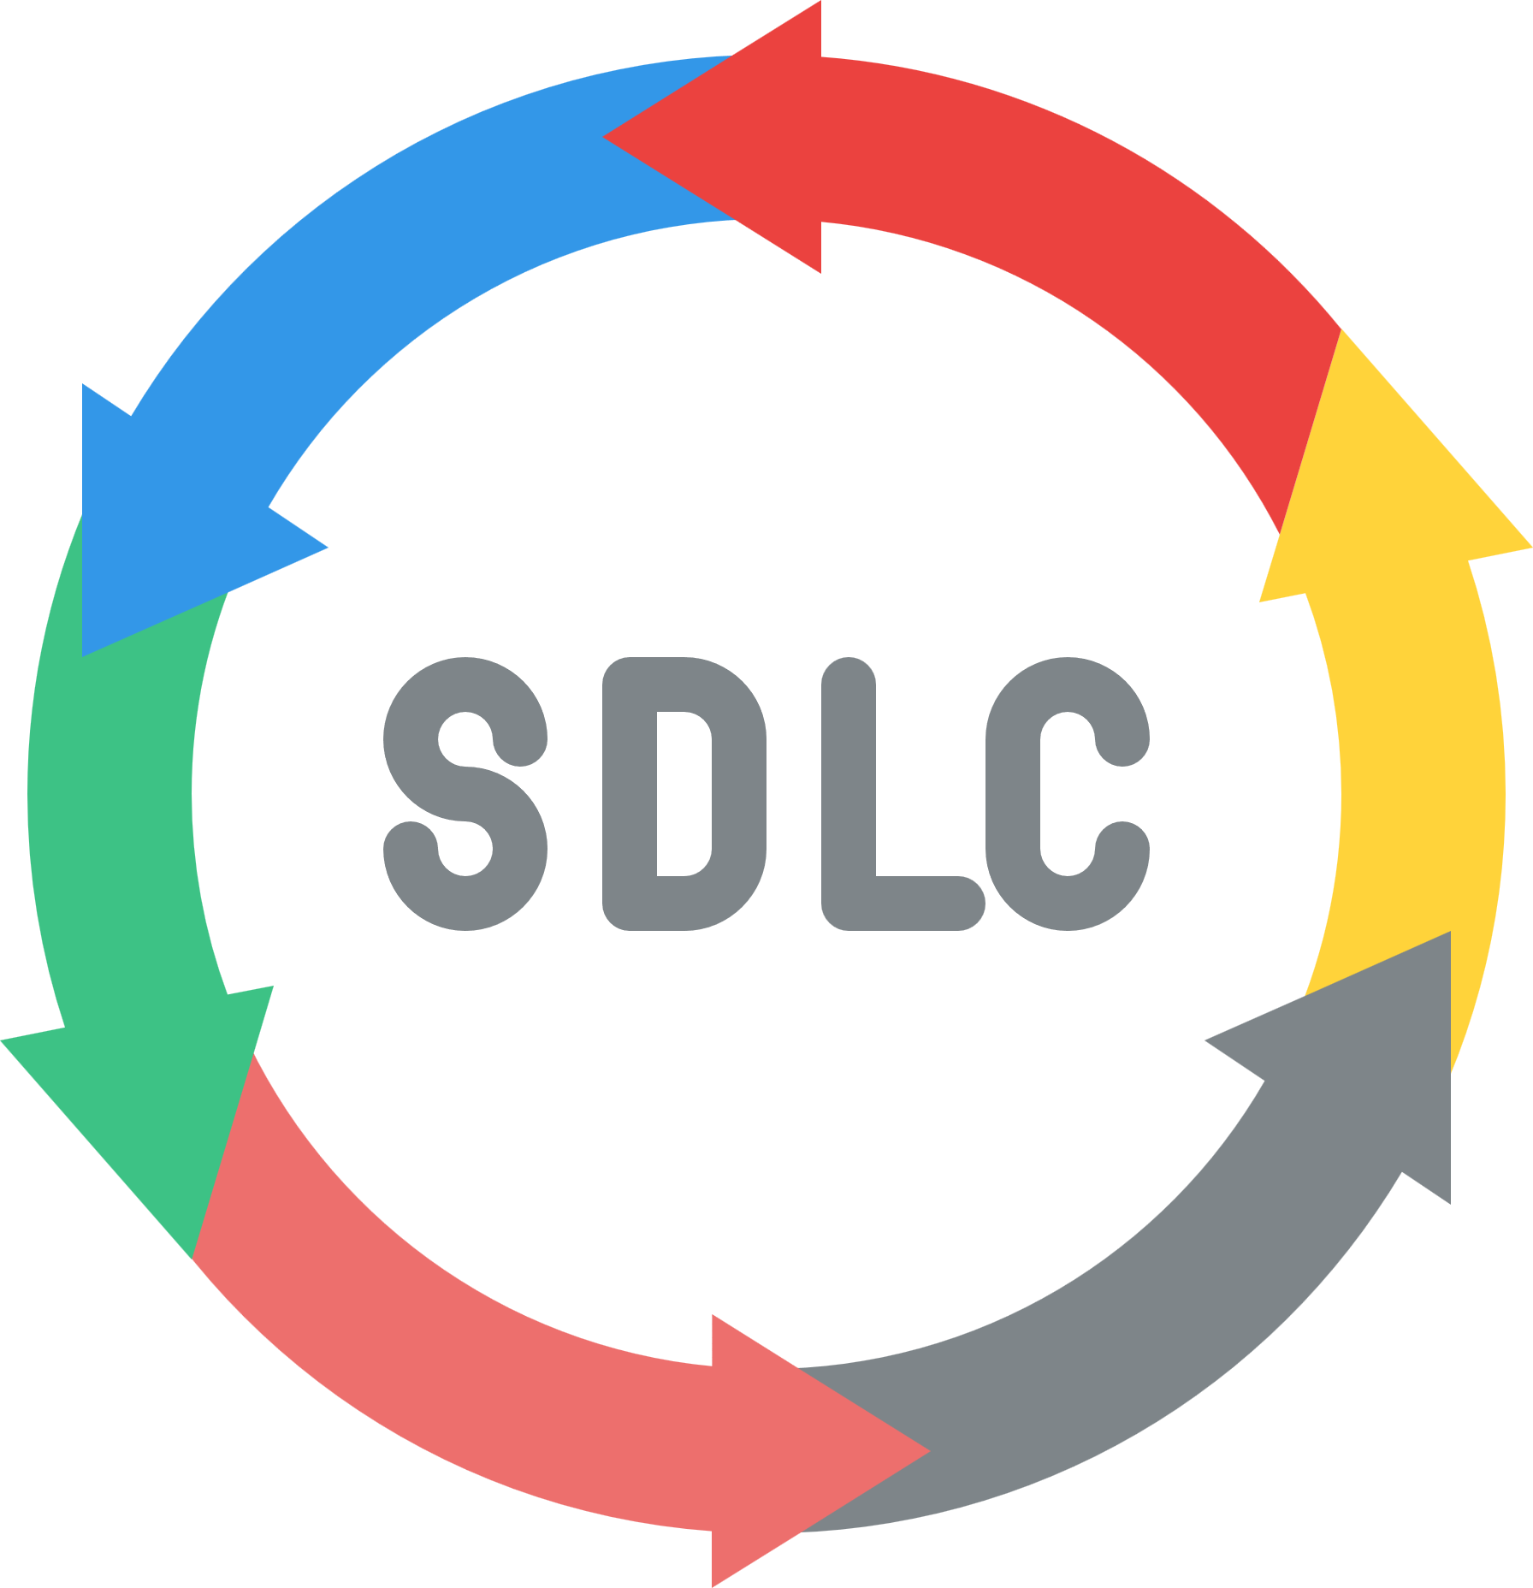
Traditional SDLC : Monolith
Requirements Gathering
Analysis
Design
Coding
Testing
Implementation
Maintenance

Slide 5


Traditional SDLC - Challenges
Requirements change
Lack of involvement of customer/business
Accuracy of estimations
Schedule and cost overruns
Not much time left for testing or fix the defects etc.,
development
release

Slide 6

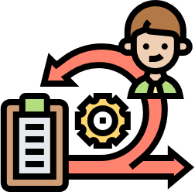
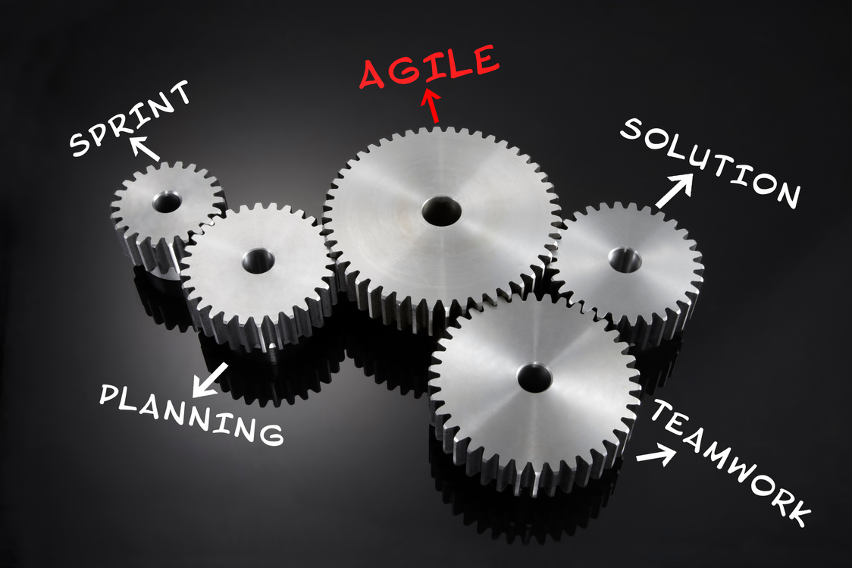
Agile SDLC : Microservices
In simple terms : Agile : Incremental process of software development
Agile understands all the requirements can’t be collected in the beginning of project
Requirements can be changed or collected through the development cycle
Tests early and often, higher quality
Reduced risk and earlier software release

Slide 7


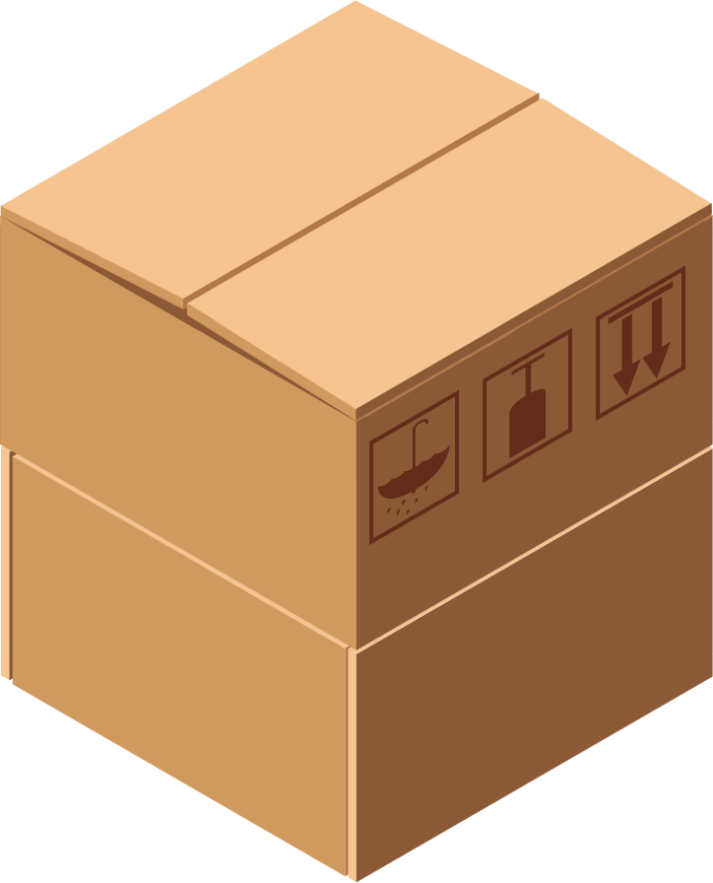
Agile SDLC - Motive
Motive:
Make sure Software Releases happen in time ensuring Quality.
Release
plan-code-test-review
Sprints

Slide 8



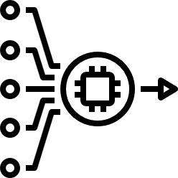
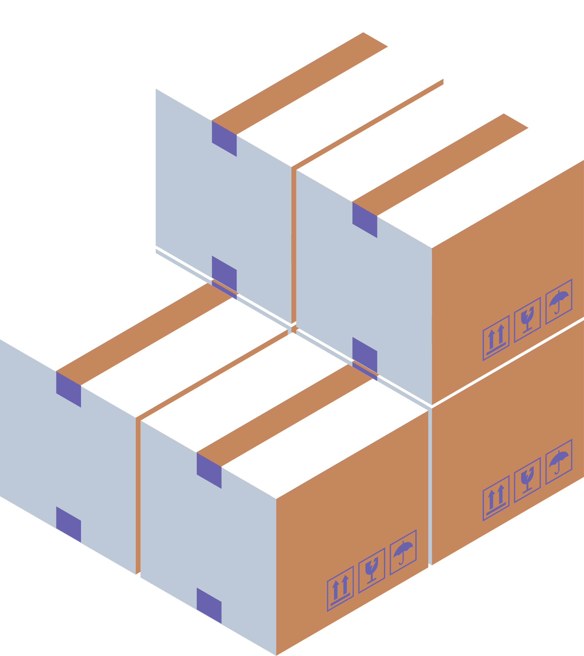



rawcode
VCS
Agile Workflow
git pull
artifact
build
BRE
Production
QA
SE
DevTeam

Slide 9
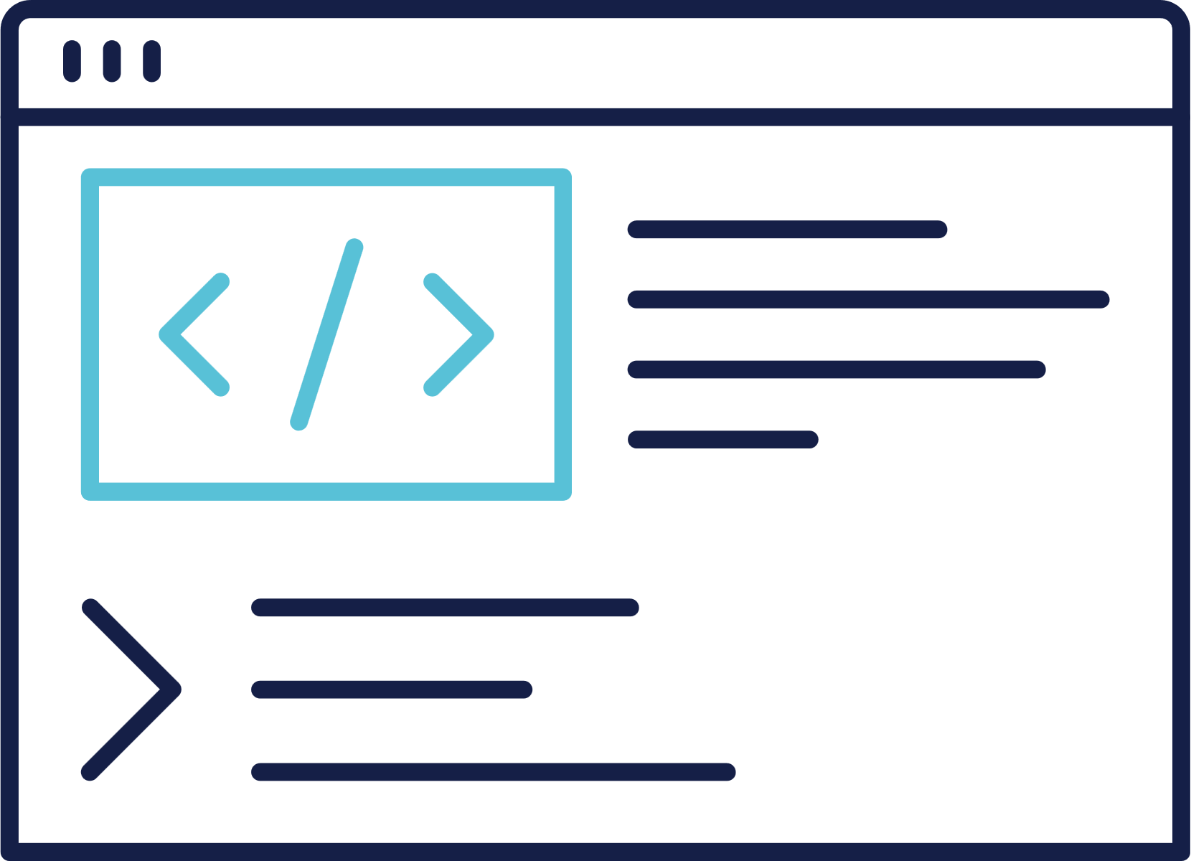
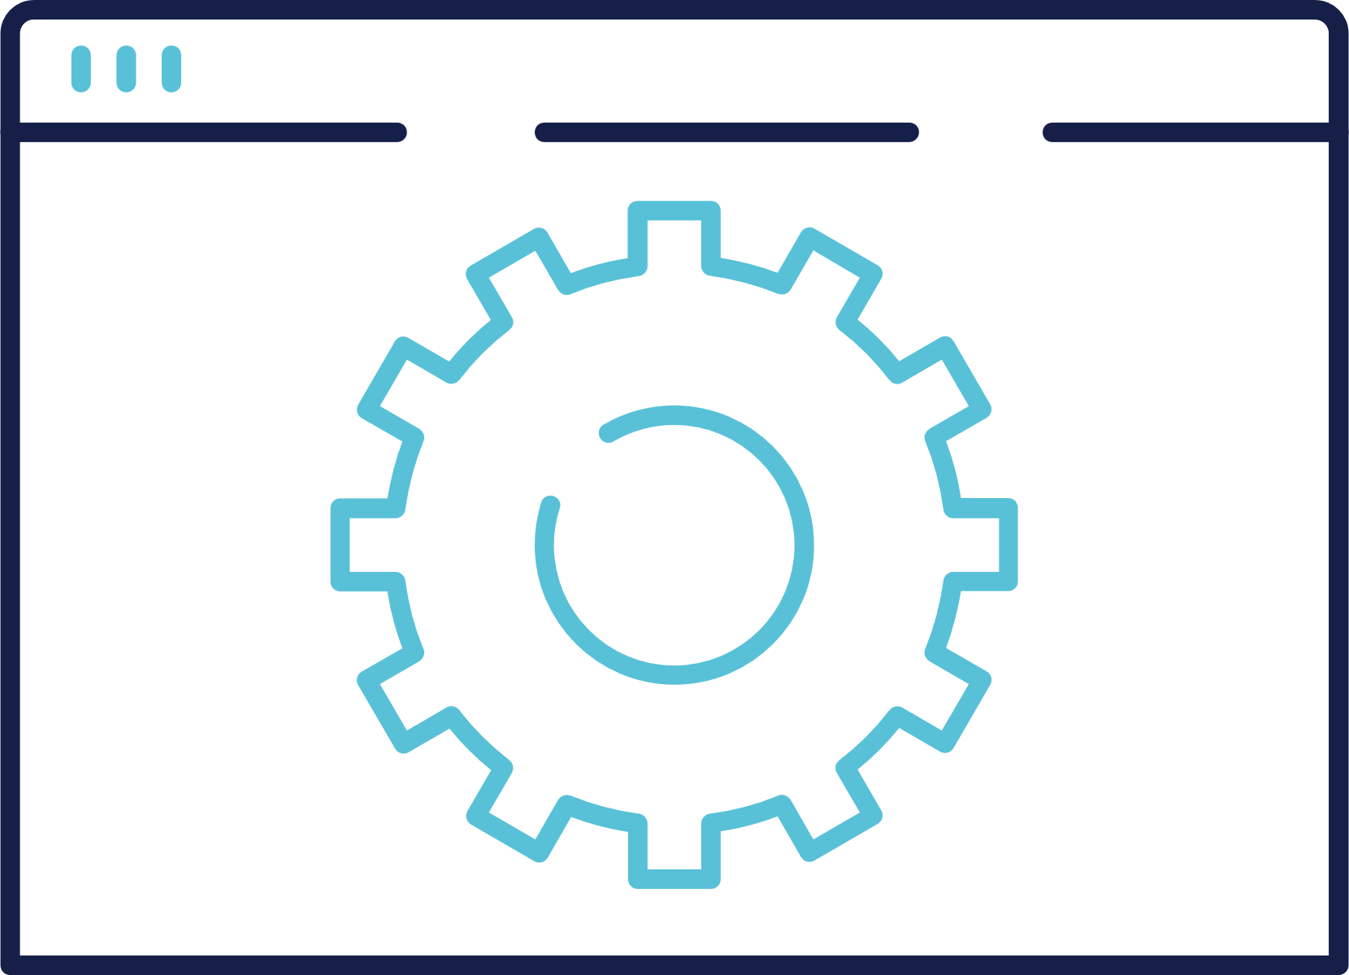
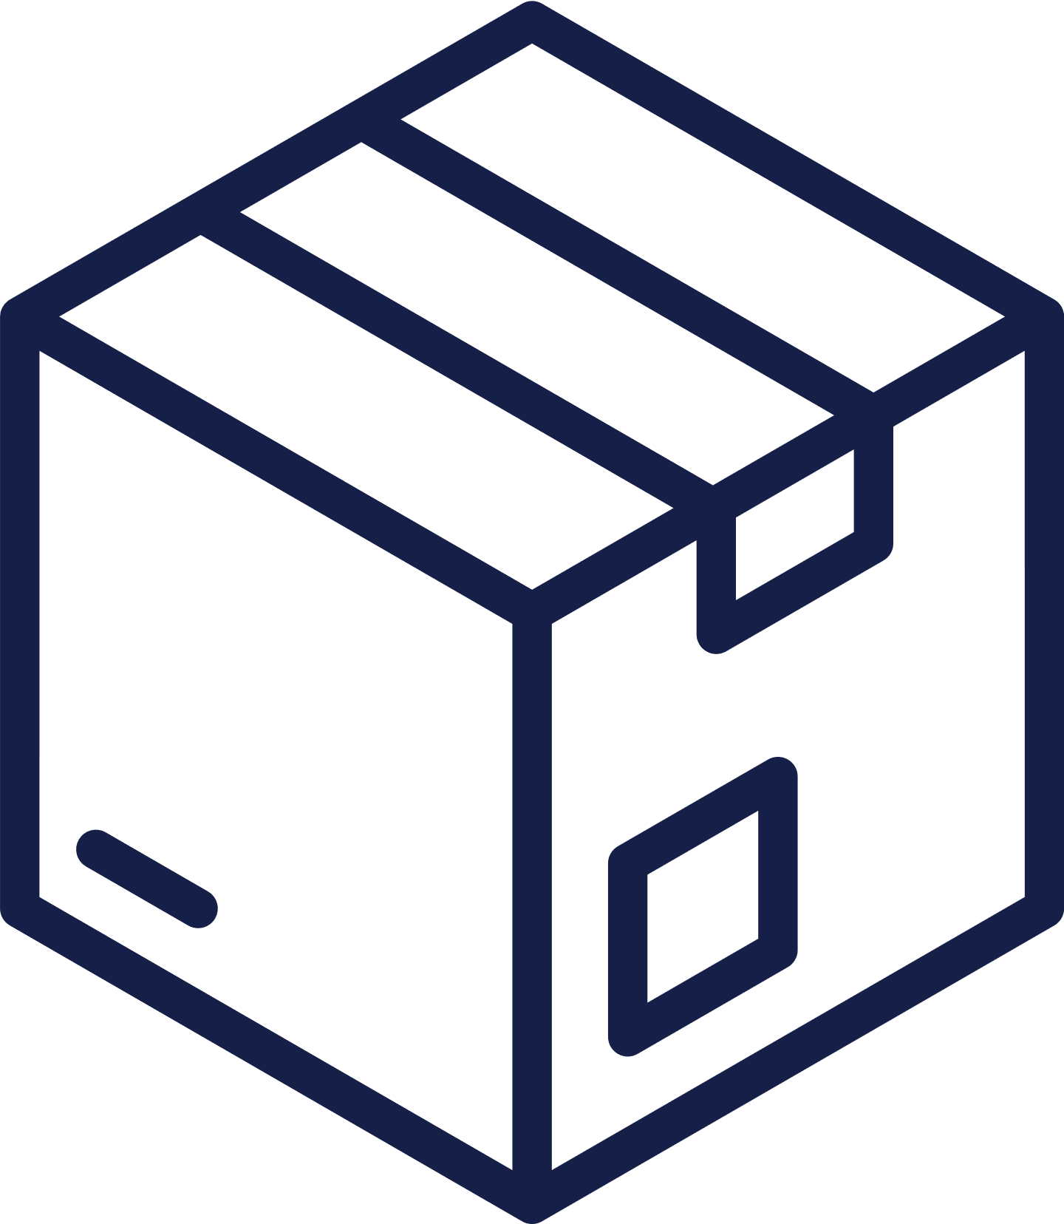
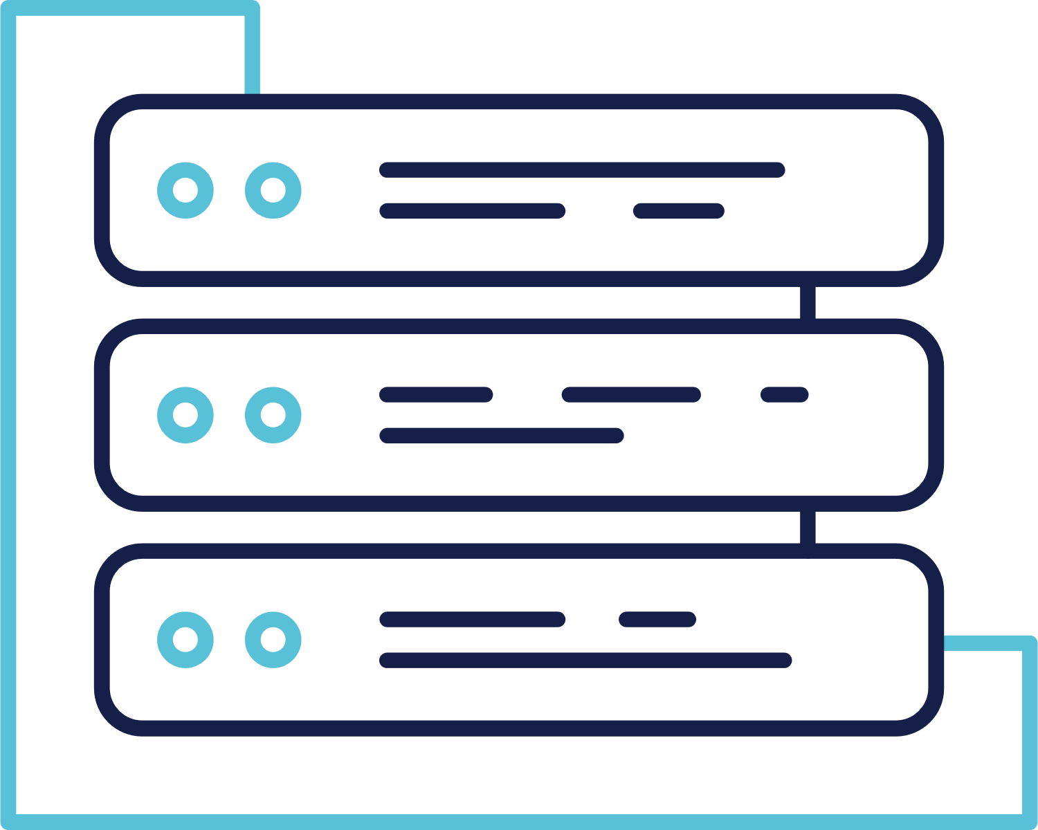
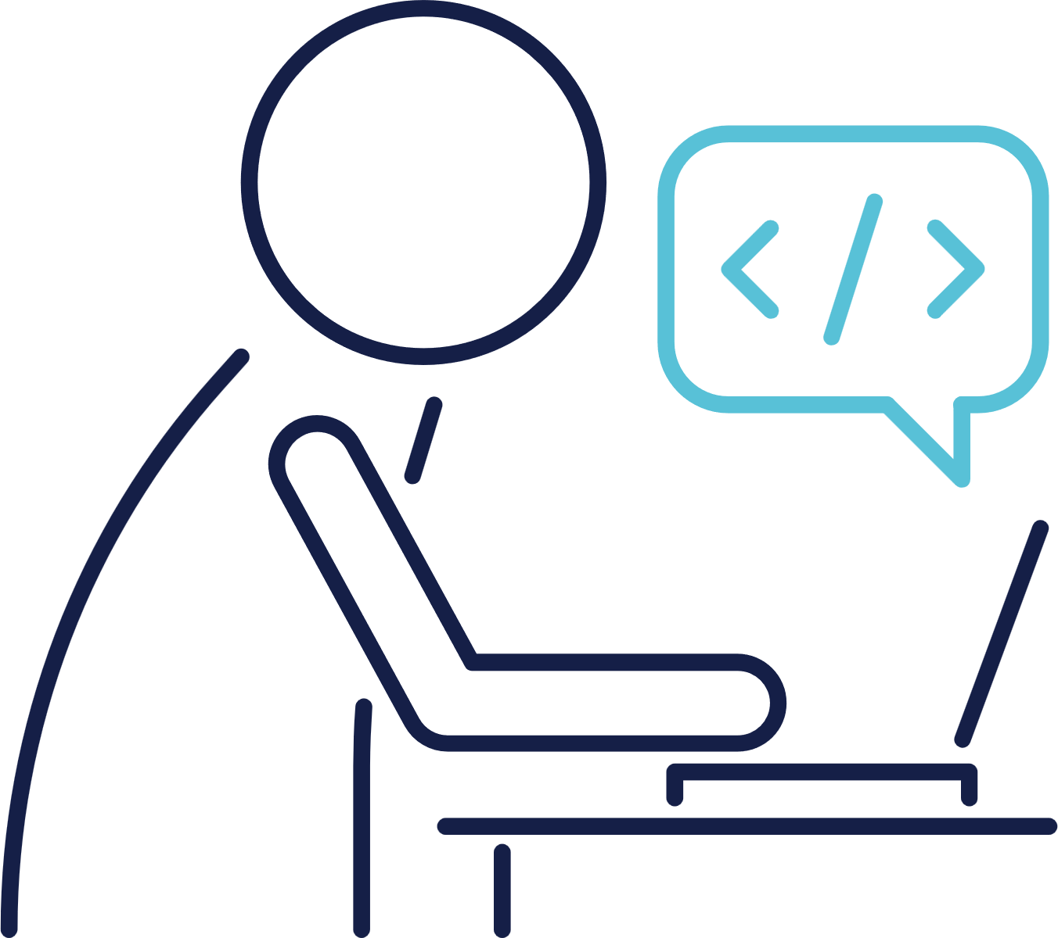
Development and Operations
Co-Ordination Issues
Developers
Front End
Back End
Test Team
Build Engineers
Release Managers
Perform tests on the application
Identify bugs, challenges
Perform Software Builds, Deploy the applications to various stages
Database Administration
Storage
Administration
System Administrators
Project Managers
Prepare the environment, Physical and cloud servers, configure them
Responsible for configuring the databases, Provide storage solutions etc.,
Presentations are communication tools that can be used reports.

Slide 10




Development and QA
Environment Issues
app
app
java8
packages1.0
java17
packages5.0
IWOMM
Problem

Slide 11


Solution
Adapt DevOps Culture
DevOps is a set of practices that combines software development (Dev) and IT operations (Ops). It aims to shorten the systems development life cycle and provide continuous delivery with high software quality. DevOps is complementary with Agile software development; several DevOps aspects came from Agile methodology.

Slide 12

Solution
automation
collaboration
communication

Slide 13
rawcode
GitHub
DevOps Workflow
Cloud Native
Infra Automation
MSA
Docker Image
git pull
BuildServers
CI-Servers
Production
QA-Automation
DevTeam

Slide 14
DevOps Best Practices
Environment Issues
Continuous Development
Continuous Integration
Continuous Testing
Continuous Delivery
Security
Continuous Deployment
Infrastructure Automation
Configuration Management
Continuous Monitoring

Slide 15
Pre-requisites
1
2
3
Linux Basics
Shell Scripting
Networking Basics

Slide 16



04
Coding required?
To a certain extent. Scripting knowledge is required to automate repetitive tasks, re-use the code as and when required.
Shell Scripting and Python Scripting are priorities
No Deeper Knowledge of Programming is required

Slide 17

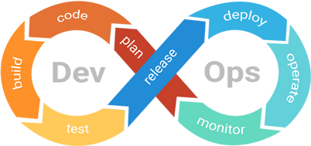
Course Outline
Linux and Shell Scripting
Docker and Docker Swarm
01
05
The basic pre-requisites to get started with DevOps and Cloud
Containers, Images, Networks, Microservices
Git and GitHub
Kubernetes
02
06
Source Code Management and Version Controlling Tools
Container Orchestration
Maven, Nexus, Tomcat, SonarQube
Terraform and Ansible
03
07
Build Tool, Artifactory repository management, Code Coverage Tools
Infrastructure Automation and
Configuration Management
Jenkins
AWS and Miscellaneous
04
08
Continuous Integration and Continuous Delivery
AWS Services, Interview Questions, Miscellaneous Tools and concepts

Slide 18
Thank You

